Slide 1
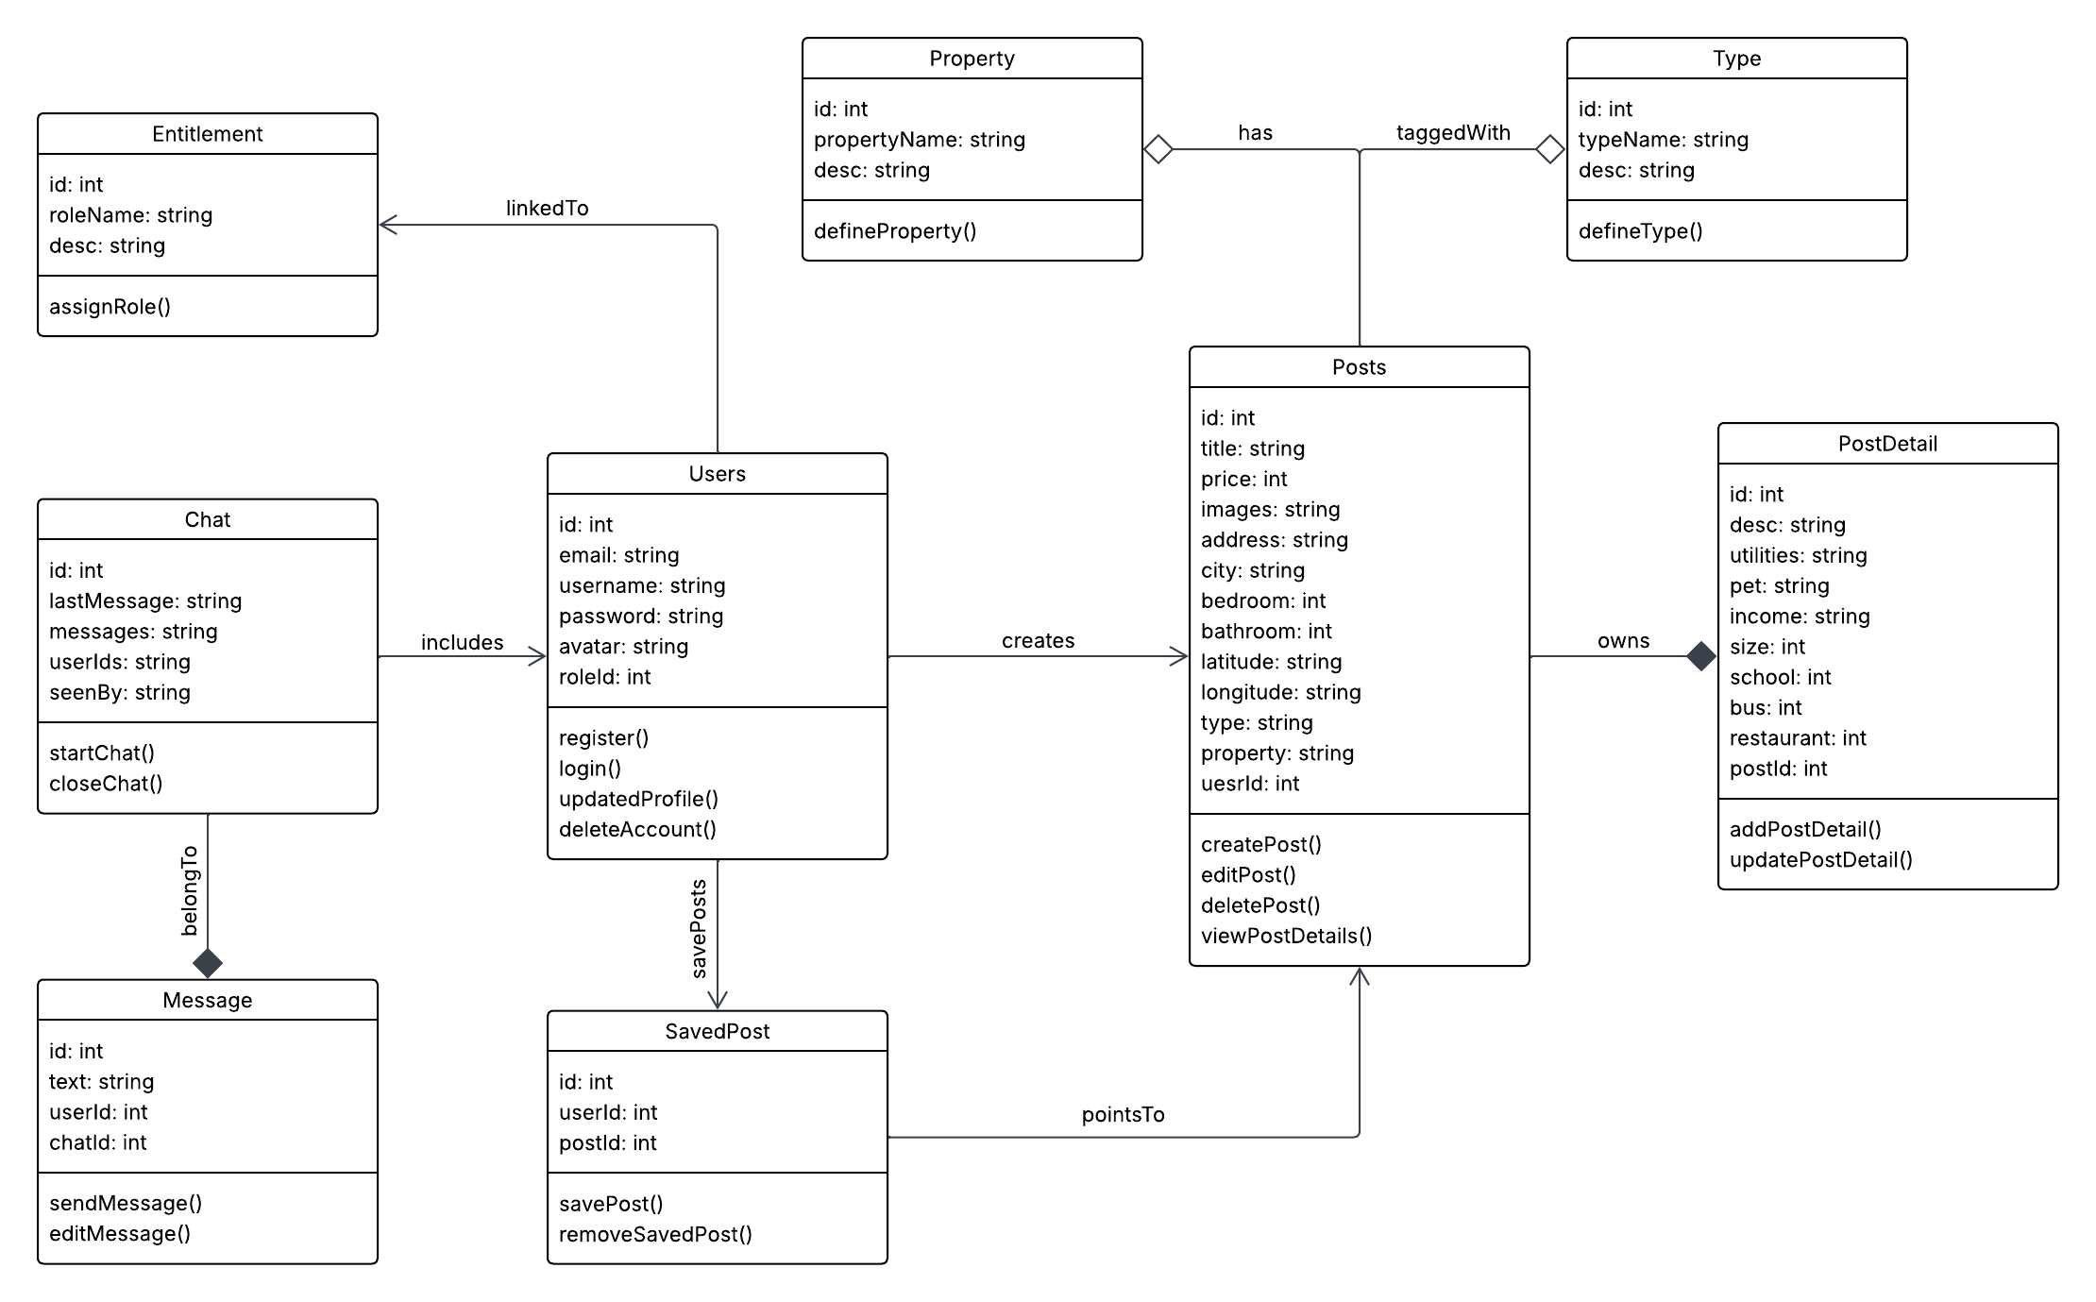
UML Class Diagram – House Hunt

